Slide 1
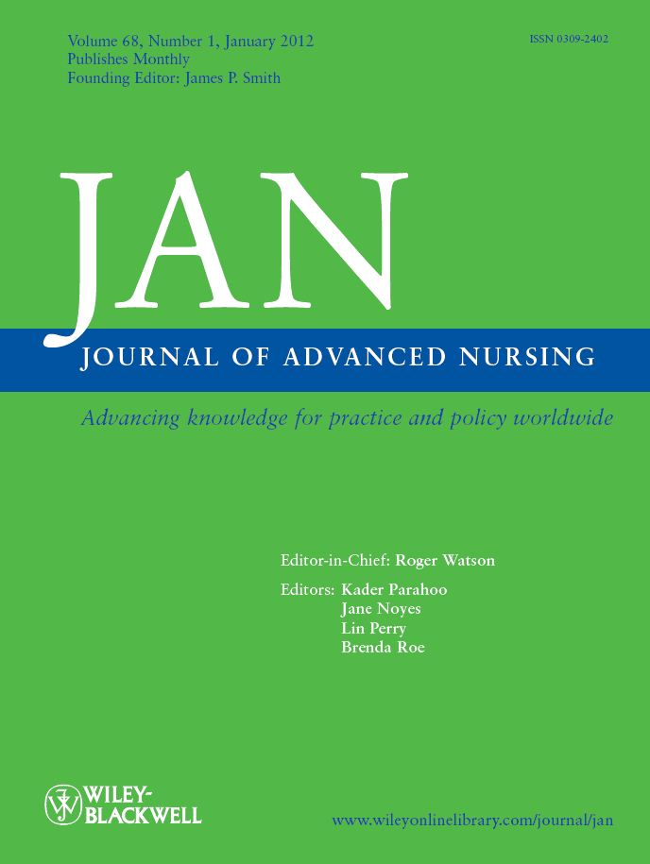
Content Summary
covers all aspects of nursing care, education, management and research
orientated towards intermediate and advanced nursing staff
publishes research papers, news and books reviews
essential reading for senior nurses, midwives, and advanced nursing students
contains perspectives and commentaries on relevant issues, summaries and critiques of research studies
Advanced Practice Nursing

Slide 2
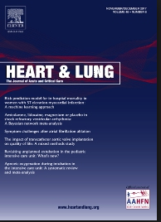
Content Summary
the official publication of The American Association of Heart Failure Nurses
presents original, peer-reviewed articles on techniques, advances, investigations, and observations related to the care of patients with acute or critical illness
Cardiac Nursing

Slide 3
Content Summary
focuses on all aspects of community practice, schools, homes, visiting nursing services, hospitals, education and public health administration
Community Health Nursing

Slide 4
Content Summary
provides useful information concerning the bedside care of critically and acutely ill patients
Critical Care Nursing

Slide 5
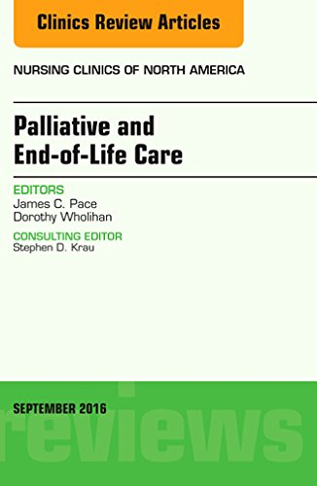
Content Summary
consulted by nurses in the intensive care unit
provides answers to clinical questions, updates on the latest advances to improve patient outcomes, numerous clinical images, and patient care guidelines
provides a wide breadth of critical and acute care nursing practice information
Critical Care Nursing

Slide 6
Content Summary
helps nurses integrate issues of faith and nursing practice
offers relevant information on clinical topics, research, spiritual care, ethics, faith, healing, personal growth and self-care.
Faith & Community Nursing

Slide 7
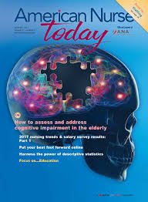
General Nursing
Content Summary
integrates the art and science of nursing
articles range from latest in clinical trends, opinions, innovations, health policy updates to breaking news to the newest drugs, devices and alternative
therapies

Slide 8
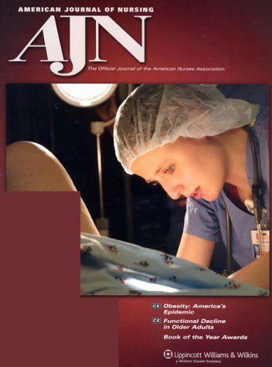
Content Summary
the oldest running nursing journal in the world
features the latest clinical research, healthcare news, commentaries and legal advice
provides evidence based clinical information, original research, news alerts, clinical briefs, insights on ethical issues and current nursing trends
General Nursing

Slide 9
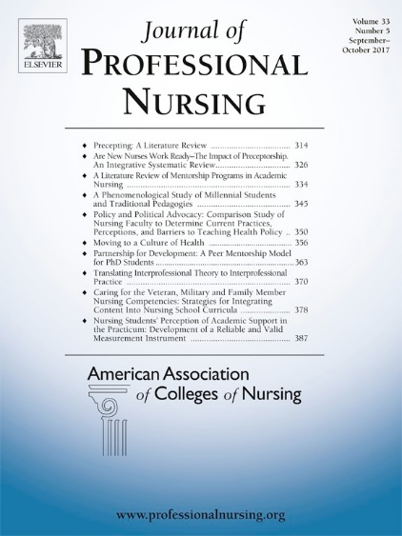
Content Summary
topics covered include innovations and trends within clinical nursing practice, patient population management, health care systems, ethical/legal trends, and the impact of legislative/regulatory actions on health care practice
General Nursing

Slide 10
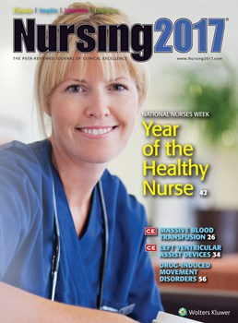
Content Summary
updates FDA drug approvals, nursing care techniques, emerging diseases, legal considerations in patient care, CDC warnings and guidelines, new state healthcare laws and recent research studies
General Nursing

Slide 11
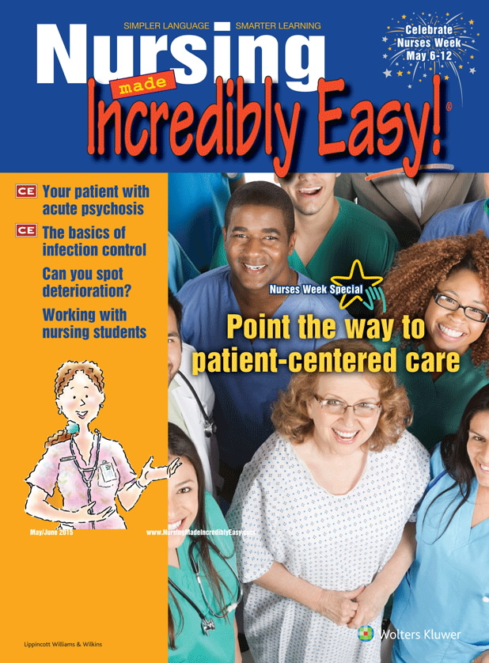
Content Summary
breaks down difficult nursing concepts
presents nursing topics in a fun and engaging way
provides colorful cheat sheets, nursing mnemonics, memory aides and studying tips
General Nursing

Slide 12
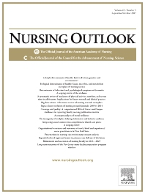
Content Summary
the official journal of the Academy of Nursing
examines current issues and trends in nursing practice, education and research
discusses advances in health policy and practice
General Nursing

Slide 13
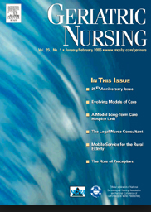
Summary Content
reports the latest developments in the management of acute and chronic disorders
provides practical advice on care of older adults across the long term continuum
addresses current issues related to drugs, advance directives, staff management, legal issues, client and caregiver education and infection control
Geriatric Nursing

Slide 14
Summary Content
provides original articles on the practice of gerontological nursing across the continuum of care in a variety of settings
Geriatric Nursing

Slide 15
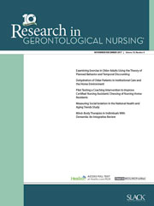
Summary Content
provides quantitative, qualitative, methodological, and theoretical research articles
features intervention studies and State of the Science Commentary
focuses on issues relevant to nurses in community practice, schools, homes, clinics and hospice settings
Geriatric Nursing

Slide 16
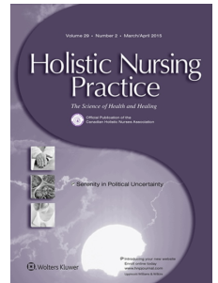
Holistic Nursing
Summary Content
focuses on the holistic approach of nursing care
features articles that address clinical and psychosocial concerns of patients

Slide 17
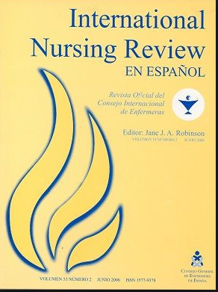
International
Nursing
Content Summary
discusses the regulation of the profession, workplace issues, practice innovations, patient safety, quality improvement midwive work life experiences, and the impact of technology on nursing

Slide 18
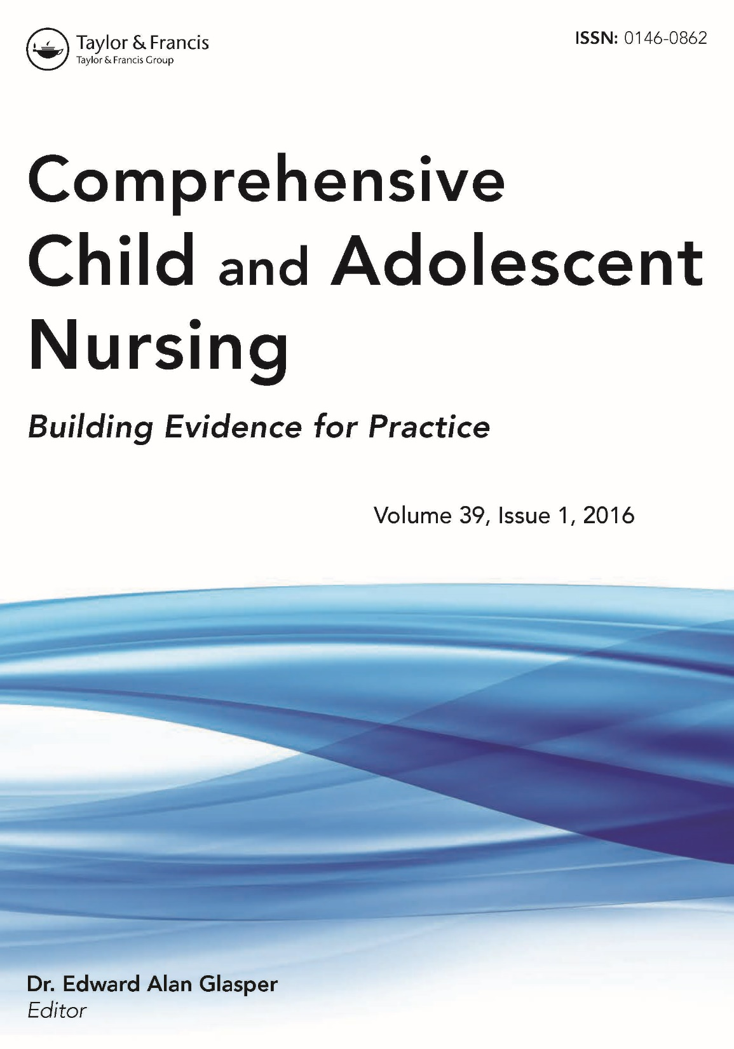
Content Summary:
provides in-depth knowledge of primary and/or acute health care for children, adolescents and their families with a developmental and behavioral focus
discusses early intervention, program development and evaluation, advanced adolescent/pediatric assessment and nutrition
Maternal-Child Nursing

Slide 19
Maternal-Child Nursing
Content Summary
focuses on in maternal/child nursing, women's health, and family nursing
coverage includes updates on disease care, ideas on health promotion, insights into patient and family behavior, and recent discoveries in physiology and pathophysiology

Slide 20
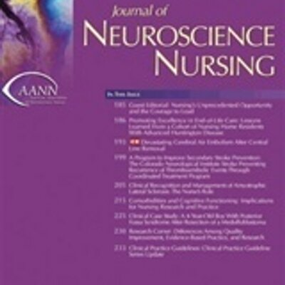
Neurosurgical Nursing
Summary Content
contains original articles on advances in neurosurgical and neurological techniques commentary on the roles of the neuroscience nurse
discusses areas of neuroscience patient care (rehabilitation medical-surgical pediatric emergency trauma and surgical units)

Slide 21
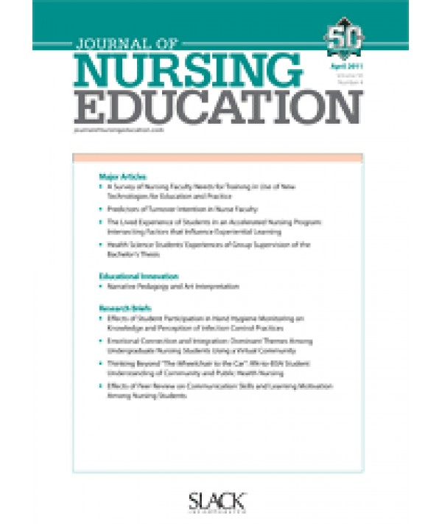
Nursing Instruction
Summary Content
contains original articles and new ideas for nurse educators in various types and levels of nursing programs
provides description of the teaching-learning process, curriculum development and nurse education research
special features include educational innovations, research briefs and syllabus selections

Slide 22
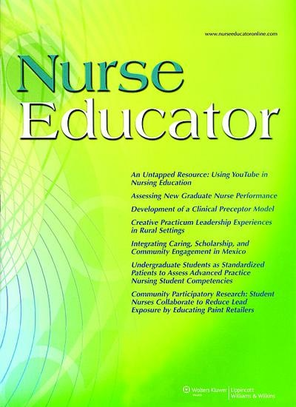
Nursing Instruction
Summary Content
featured topics include curriculum, nursing courses, teaching methods, preparing and mentoring student nurses
discusses how to design, implement, evaluate and revise academic and continuing education programs

Slide 23
Nursing Management
Summary Content
source of information for nurse executives, directors of nursing, and nurse managers in hospital, community health, and ambulatory care environments
includes topics such as leadership development, financial resource management staffing and scheduling systems.

Slide 24
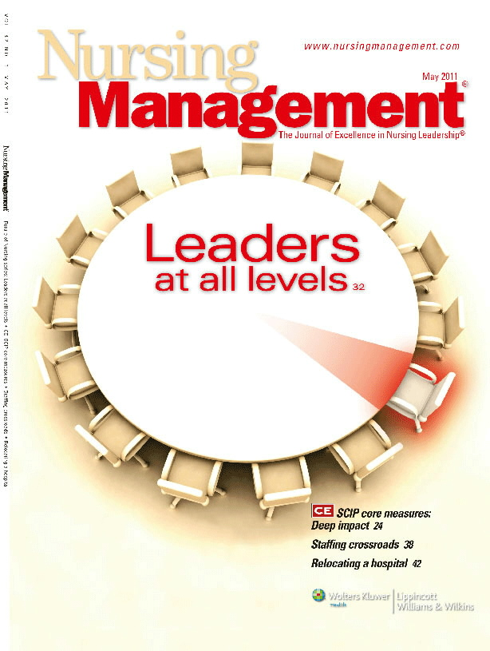
Nursing Management
Summary Content
covers the practice of nursing management, the performance of the leadership functions of governance and decision-making
includes the process of management, planning, organizing, staffing, directing and controlling personnel

Slide 25
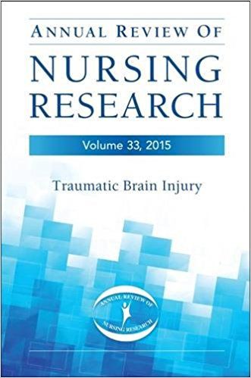
Nursing Research
Summary Content
critically examines literature on nursing practice, including nursing theory, care delivery, nursing education professional aspects

Slide 26
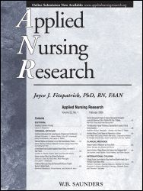
Nursing Research
Summary Content
presents original, peer-reviewed research findings for clinical applications in all nursing specialties
features include "Ask the Experts," research briefs, clinical methods, book reviews, news and announcements
covers areas such as pain management, patient education, discharge planning, nursing diagnosis, and nurse/physician collaboration

Slide 27
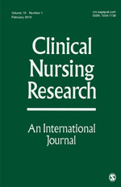
Summary Content
addresses issues of clinical research meaningful to practicing nurses
pinpoints potential clinical applications of the latest scholarly research and disseminates research findings
Nursing Research

Slide 28
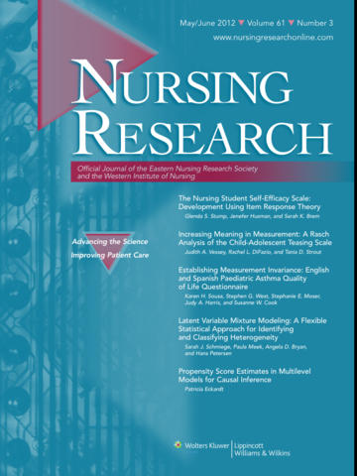
Nursing Research
Content Summary
covers the field of nursing science since 1952
provides evidence-based care articles that promote quality health outcomes for individuals, families, communities and health care systems
uses research to shape health policy within an organization

Slide 29
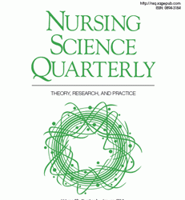
Nursing Research
Content Summary
publishes original manuscripts focusing on nursing theory frameworks, guided practice, quantitative and qualitative research
focuses on innovative ideas related to nursing science and person centered models of care.

Slide 30
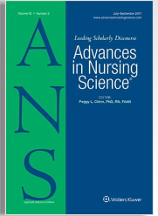
Nursing Scholarship
Content Summary
features scholarly articles, timely research studies, emerging nursing theories, scholarly articles and research papers

Slide 31
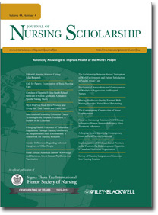
Nursing Scholarship
Content Summary
looks at improving nursing on a global scale and covers the future direction of nursing

Slide 32
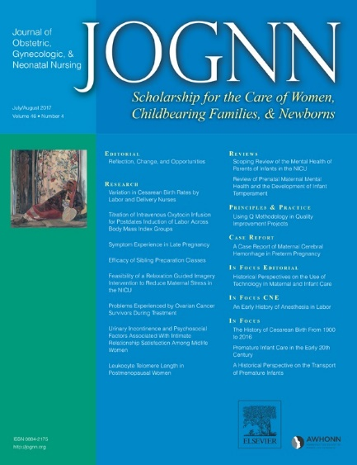
Content Summary
clinical scholarship that advances the health care of women and newborns
addresses the latest research, practice issues, policies, opinions, and trends in the care of women, childbearing families, and newborns
balances quantitative and qualitative research with an emphasis on bio-behavioral outcome studies and intervention trials
Obstetrical Nursing

Slide 33
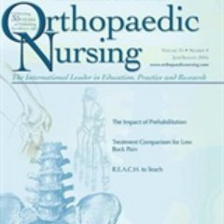
Orthopedic Nursing
Content Summary
contains information on current events, organizational activities, research, product, drug information, and literature findings
focuses on professional development in the clinical, administrative, academic, and research areas

Slide 34
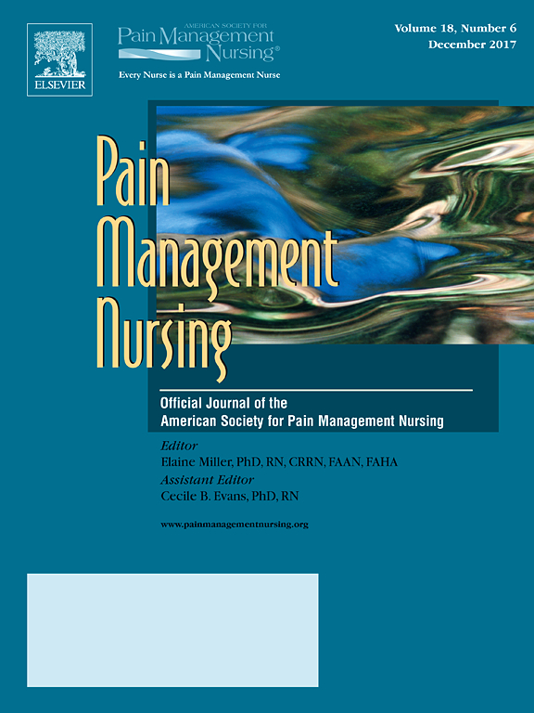
Pain Management Nursing
Content Summary
offers key insights in the areas of clinical practice, advocacy, education, administration and research
features include practice guidelines and pharmacology updates

Slide 35
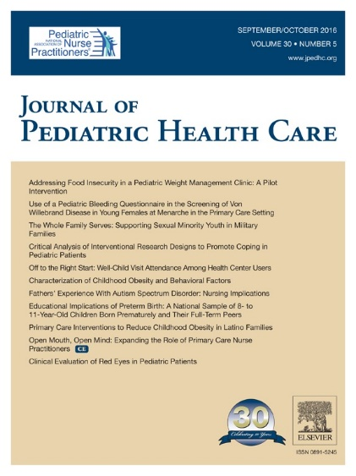
Pediatric Nursing
Summary Content
provides scholarly clinical information and research regarding primary, acute and specialty health care for children from newborn age through young adulthood
disseminates multidisciplinary perspectives on evidence-based practice,emerging policy, advocacy and educational issues for children and families

Slide 36
Pediatric Nursing
Summary Content
focuses nurse needs in pediatric practice, research, administration, and education in hospital, clinic, office, school, community, or home settings

Slide 37
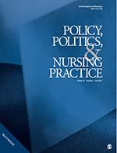
Summary Content
explores the multiple relationships between nursing and health policy
serves as a major source of data-based study, policy analysis and discussion on timely, relevant policy issues for nurses in a broad variety of roles
Public Policy Nursing

Slide 38
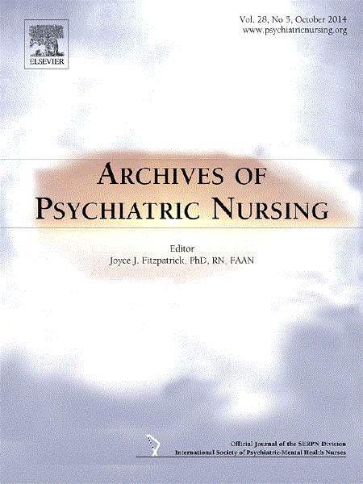
Summary Content
disseminates original, peer-reviewed research of interest to psychiatric and mental health care nurses for in diverse areas of practice related settings for interdisciplinary collaboration
Psychiatric Nursing

Slide 39
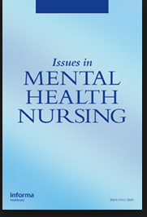
Psychiatric Nursing
Summary Content
presents data-based articles on nursing care in a variety of community and institutional settings
publishes theoretical papers and manuscripts addressing mental health issues, public and policy concerns

Slide 40
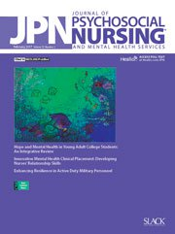
Psychiatric Nursing
Summary Content
provides practical information for psychosocial-mental health nurses, including information on psychopharmacology, mental health care for older adults, addictive behaviors and diagnoses, and child/adolescent disorders
features “Clip & Save: Drug Chart,” a one-page resource of up-to-date information on current medications for various psychiatric illnesses

Slide 41
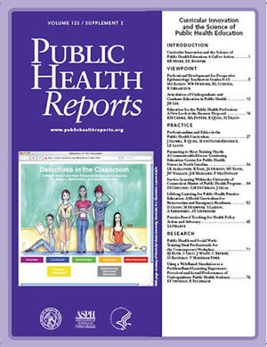
Summary Content
focuses on topics such as tobacco control, teenage violence, occupational injuries immunization, drug policy, lead screening, and health practice methodology
contains commentary by the U.S. Surgeon General and U.S. Health Human Services officials
Public Health

Slide 42
Summary Content
address the growing addiction problem
focuses on discussing prevention, intervention, management and treatment of substance abuse or addictive problems
Substance Abuse Nursing

Slide 43
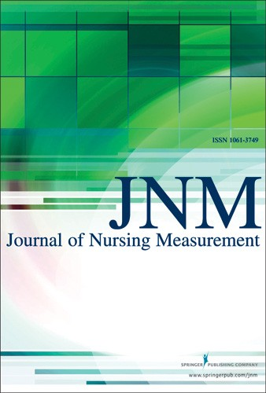
Content Summary
addresses information on instruments, tools, approaches, and procedures utilized for measuring variables in nursing research, practice and education
discusses theories, principles practices and issues relevant to nursing measurement
Nursing Statistics

Slide 44
Content Summary
topics include decision-making models used by medical-surgical nurses, psychological outcomes related to various health conditions and evidence-based practice
Medical Surgical Nursing

Slide 45
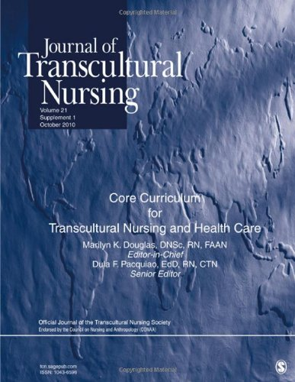
Transcultural Nursing
Content Summary
discuss issues from international researchers, practitioners about the relationship between culture and health care
promotes dissemination of research findings that foster the exchange of opinions from multiple perspectives

Slide 46
Women’s Health
Content Summary
presents information on obstetric and neonatal topics, including cardiovascular, reproductive and pre-menopausal health, cancer, nutrition, aging, high-risk labor and newborn care

